Slide 1
Faculty Senate Meeting
October 20, 2022

Slide 2
Meeting procedure
Only Senators may debate motions
Only Senators can vote
If you are not a Senator, or a proxy, you cannot vote or debate
Do not speak over someone, or out of order
  Raise your hand to speak
  The President may call on you and then you will have the floor
Unless you have been recognized (been told you have the floor), you may not speak

Slide 3
Meeting Minutes
We will be using Robert's Rules to guide our recording of minutes.
Robert's Rules of Order say that meeting minutes are simply a summary of what happened at the meeting.
They are not a play by play of everything that happened or what members said.
If needed, Faculty Senators may request access to the audio recording of the meeting. Please email facsenate@mst.edu with justification.

Slide 4
Agenda
Call to Order and Roll Call
D. Westenberg, Secretary

Slide 5
Agenda
Approval of Minutes
September 22, 2022

Slide 6
Agenda
III. President’s Report
K. Sheppard

Slide 7
Gen Fac Meetings: Purpose
  1: C & P give State of the University-type reports, open for questions.
    Introduction of new faculty
  2: C & P report on what is different or new from the first report, open for questions
    General campus reports
  3: C & P report on progress over the year, what’s coming for next year, open for questions
    Academic appreciations
    Memorial resolutions

Slide 8
Gen Fac Meetings and You, the Gen Fac
  This is where to hear the Chancellor and Provost and their plans/visions for campus for the year.
  If you have questions, please come to the meeting to ask them
  If you have questions but don’t feel comfortable asking them, email me and I will ask them for you
Faculty Senate meetings
  By Laws: D.4.a. The Faculty Senate is the legislative and policy-making body of the General Faculty
  C & P are here to answer some questions

Slide 9
Climate Survey
  We are reporting on that today, so you will have time to ask questions of C & P there
Emeritus Faculty/Retired Staff email access
  We are looking at this
Annual Campus Memorial Concept
  Honoring students, staff, and faculty who have passed away over the previous year
  Would like a faculty senator to serve for input

Slide 10
COACHE survey will be happening this coming Spring
FRRC reboot as possible task force
Library Dean search starting soon

Slide 11
Questions?

Slide 12
Agenda
IV. Campus Reports
  A. Staff Council
  M. Fowler
  (No Report)

Slide 13
Agenda
IV. Campus Reports
  B. Student Council
  W. Retzlaff

Slide 14
3 Biggest Concerns on Campus
  Differential Tuition Model
  S&T expansion vs. quality of education
  Teacher evaluations (CET)
Planning leadership curriculum for 2023-2024
General Body Meeting week of October 25th

Slide 15
Agenda
IV. Campus Reports
  C. Council of Graduate Students
  Manoj Twarakavi
  (No Report)

Slide 16
Agenda
V. Special Topic
  Missouri S&T ADVANCE Grant
  J. Cundiff

Slide 17

NSF ADVANCE Adaptation:
Creating a Destination of Choice at S&T
What is the NSF ADVANCE program?
Designed to foster gender equity by identifying and eliminating organizational barriers that impede full participation and advancement of diverse faculty in academic institutions
ADVANCE “Adaptation” awards provide support for the adaptation and adoption of evidence-based strategies to academic institutions
  S&T ADVANCE Team:
  PI: Jessica Cundiff
  Co-PIs: Colin Potts, Kate Drowne, Richard Brow, Robert Marley
  Senior Personnel: Daniel Reardon, Daniel Forciniti

Slide 18
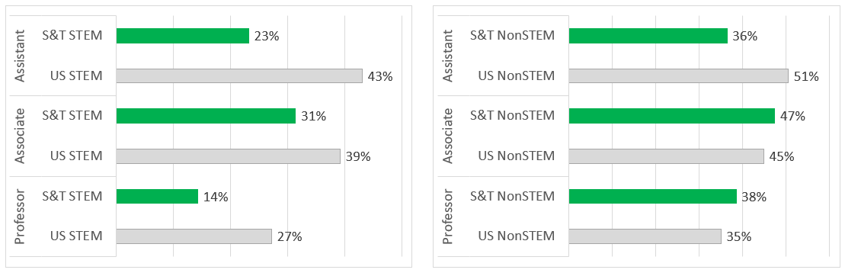
Problem Analysis at S&T
Overarching problem:
  Women, especially women of color, are underrepresented at S&T across STEM faculty ranks and leadership positions, compared to US universities
% Women faculty in STEM
% Women faculty in Non-STEM

Slide 19
Problem Analysis at S&T
Overarching problem:
  Women, especially women of color, are underrepresented at S&T across STEM faculty ranks and leadership positions, compared to US universities
Chilly Climate
Gender Bias
Inequitable resource distribution

Slide 20
Project Objectives and Goals
Overarching Goal:
  Increase representation of women (especially from underrepresented racial-ethnic groups) across faculty ranks and leadership by making S&T a destination of choice where all faculty can thrive
Immediate Focus
Cultivate inclusive climate
Mitigate gender bias
Equitable resource distribution

Slide 21
Strategies
Distinguished Lecture Series
Leadership Workshops
Mid-career Faculty Workshops
Search Committee Training
Education and Leadership Development
  Engage current and aspiring leaders as equity-minded change agents
Improve Local Climates through Targeted Support
  Empower departments to address DEI problems of their own choosing
Department Enhancement Grants
Transform Univ. Structures, Policies, Procedures
  Emphasis on accountability
Faculty Fellows Program
Revise Policies and Accountability Structures
New Ombud Position

Slide 22
Agenda
VI. Reports of Standing Committees
A. Public Occasions
S. Sedigh Sarvastani

Slide 23
Public Occasions Committee Report
Dr. Sahra Sedigh Sarvestani, Chair
Motion to adopt academic calendars for
2023-2024, 2024-2025, and 2025-2026

Slide 24
Motion
The Public Occasions Committee moves that the following academic calendars be adopted for 2023-2024, 2024-2025, and 2025-2026, respectively.

Slide 25
FALL SEMESTER 2023
Open Registration Ends | August 20, Sunday
Fall semester opens 8 am | August 21, Monday
Classwork begins 8 am | August 21, Monday
Labor Day Holiday | September 4, Monday
Fall Break Begins 8 am | October 5, Thursday
Fall Break Ends 8 am | October 9, Monday
Mid-Semester | October 14, Saturday
Thanksgiving vacation begins 8 am | November 19, Sunday
Thanksgiving vacation ends 8 am | November 27, Monday
Last Class Day | December 8, Friday
Final Examinations begin 7:30 am | December 11, Monday
Final Examinations end 5 pm | December 15, Friday
December Commencement 6 pm | December 15, Friday
PhDs in All Departments
December Commencement 10 am | December 16, Saturday
Graduate and Undergraduate Degrees in Designated Departments
December Commencement 3 pm | December 16, Saturday
Graduate and Undergraduate Degrees in Designated Departments

Slide 26
SPRING SEMESTER 2024
Open Registration Ends | January 15, Monday
Martin Luther King, Jr. Recognition Holiday | January 15, Monday
Spring semester opens 8 am | January 16, Tuesday
Classwork begins 8 am | January 16, Tuesday
Mid-Semester | March 9, Saturday
Spring Recess begins 8 am | March 14, Thursday
Spring Recess ends 8 am | March 18, Monday
Spring Break begins 8 am | March 24, Sunday
Spring Break ends 8 am | April 1, Monday
Last Class Day | May 3, Friday
Final Examinations begin 7:30 am | May 6, Monday
Final Examinations end 5 pm | May 10, Friday
Spring Semester closes 6 pm | May 10, Friday
May Commencement 6 pm | May 10, Friday
PhDs in All Departments
May Commencement 10 am | May 11, Saturday
Graduate and Undergraduate Degrees in Designated Departments
May Commencement 3 pm | May 11, Saturday
Graduate and Undergraduate Degrees in Designated Departments

Slide 27
*SUMMER SESSION 2024
Open Registration Ends | June 2, Sunday
Summer session opens 8 am | June 3, Monday
Classwork begins 8 am | June 3, Monday
Juneteenth Holiday | June 19, Wednesday
Independence Day Holiday (observed) | July 4, Thursday
Final Examinations begin 8 am | July 25, Thursday
Final Examinations end 12:30 pm | July 26, Friday
Summer Session closes 12:30 pm | July 26, Friday
*Schedule shows the regular eight-week Summer Session.
Other special four-week course sessions may be scheduled.

Slide 28
CLASS SESSIONS
(EXCLUDING FINAL EXAMINATIONS)
 | M | TU | W | TH | F | Total MWF | Total TR
Fall | 14 | 15 | 15 | 14 | 14 | 43 | 29
Spring | 14 | 15 | 15 | 14 | 14 | 43 | 29
Summer | 8 | 8 | 7 | 7 | 8 | 23 | 15
The faculty is reminded of the religious and other holidays that a substantial number of students may wish to observe.

Slide 29
FALL SEMESTER 2024
Open Registration Ends | August 18, Sunday
Fall semester opens 8 am | August 19, Monday
Classwork begins 8 am | August 19, Monday
Labor Day Holiday | September 2, Monday
Fall Break Begins 8 am | October 3, Thursday
Fall Break Ends 8 am | October 7, Monday
Mid-Semester | October 12, Saturday
Thanksgiving vacation begins 8 am | November 24, Sunday
Thanksgiving vacation ends 8 am | December 2, Monday
Last Class Day | December 6, Friday
Final Examinations begin 7:30 am | December 9, Monday
Final Examinations end 5 pm | December 13, Friday
December Commencement 6 pm | December 13, Friday
PhDs in All Departments
December Commencement 10 am | December 14, Saturday
Graduate and Undergraduate Degrees in Designated Departments
December Commencement 3 pm | December 14, Saturday
Graduate and Undergraduate Degrees in Designated Departments

Slide 30
SPRING SEMESTER 2025
Open Registration Ends | January 20, Monday
Martin Luther King, Jr. Recognition Holiday | January 20, Monday
Spring semester opens 8 am | January 21, Tuesday
Classwork begins 8 am | January 21, Tuesday
Mid-Semester | March 13, Thursday
Spring Recess begins 8 am | March 15, Saturday
Spring Recess ends 8 am | March 17, Monday
Spring Break begins 8 am | March 23, Sunday
Spring Break ends 8 am | March 31, Monday
Last Class Day | May 9, Friday
Final Examinations begin 7:30 am | May 12, Monday
Final Examinations end 5 pm | May 16, Friday
Spring Semester closes 6 pm | May 16, Friday
May Commencement 6 pm | May 16, Friday
PhDs in All Departments
May Commencement 10 am | May 17, Saturday
Graduate and Undergraduate Degrees in Designated Departments
May Commencement 3 pm | May 17, Saturday
Graduate and Undergraduate Degrees in Designated Departments

Slide 31
*SUMMER SESSION 2025
Open Registration Ends | June 1, Sunday
Summer session opens 8 am | June 2, Monday
Classwork begins 8 am | June 2, Monday
Juneteenth Holiday | June 19, Thursday
Independence Day Holiday (observed) | July 4, Friday
Final Examinations begin 8 am | July 24, Thursday
Final Examinations end 12:30 pm | July 25, Friday
Summer Session closes 12:30 pm | July 25, Friday
*Schedule shows the regular eight-week Summer Session.
Other special four-week course sessions may be scheduled.

Slide 32
CLASS SESSIONS
(EXCLUDING FINAL EXAMINATIONS)
 | M | TU | W | TH | F | Total MWF | Total TR
Fall | 14 | 15 | 15 | 14 | 14 | 43 | 29
Spring | 14 | 15 | 15 | 14 | 14 | 43 | 29
Summer | 8 | 8 | 8 | 7 | 7 | 23 | 15
The faculty is reminded of the religious and other holidays that a substantial number of students may wish to observe.

Slide 33
FALL SEMESTER 2025
Open Registration Ends | August 24, Sunday
Fall semester opens 8 am | August 25, Monday
Classwork begins 8 am | August 25, Monday
Labor Day Holiday | September 1, Monday
Fall Break Begins 8 am | October 9, Thursday
Fall Break Ends 8 am | October 13, Monday
Mid-Semester | October 18, Saturday
Thanksgiving vacation begins 8 am | November 23, Sunday
Thanksgiving vacation ends 8 am | December 1, Monday
Last Class Day | December 12, Friday
Final Examinations begin 7:30 am | December 15, Monday
Final Examinations end 5 pm | December 19, Friday
December Commencement 6 pm | December 19, Friday
PhDs in All Departments
December Commencement 10 am | December 20, Saturday
Graduate and Undergraduate Degrees in Designated Departments
December Commencement 3 pm | December 20, Saturday
Graduate and Undergraduate Degrees in Designated Departments

Slide 34
SPRING SEMESTER 2026
Open Registration Ends | January 19, Monday
Martin Luther King, Jr. Recognition Holiday | January 19, Monday
Spring semester opens 8 am | January 20, Tuesday
Classwork begins 8 am | January 20, Tuesday
Mid-Semester | March 12, Thursday
Spring Recess begins 8 am | March 14, Saturday
Spring Recess ends 8 am | March 16, Monday
Spring Break begins 8 am | March 22, Sunday
Spring Break ends 8 am | March 30, Monday
Last Class Day | May 8, Friday
Final Examinations begin 7:30 am | May 11, Monday
Final Examinations end 5 pm | May 15, Friday
Spring Semester closes 6 pm | May 15, Friday
May Commencement 6 pm | May 15, Friday
PhDs in All Departments | May 16, Saturday
May Commencement 10 am
Graduate and Undergraduate Degrees in Designated Departments | May 16, Saturday
May Commencement 3 pm
Graduate and Undergraduate Degrees in Designated Departments

Slide 35
*SUMMER SESSION 2026
Open Registration Ends | May 31, Sunday
Summer session opens 8 am | June 1, Monday
Classwork begins 8 am | June 1, Monday
Juneteenth Holiday | June 19, Friday
Independence Day Holiday (observed) | July 3, Friday
Final Examinations begin 8 am | July 23, Thursday
Final Examinations end 12:30 pm | July 24, Friday
Summer Session closes 12:30 pm | July 24, Friday
*Schedule shows the regular eight-week Summer Session.
Other special four-week course sessions may be scheduled.

Slide 36
CLASS SESSIONS
(EXCLUDING FINAL EXAMINATIONS)
 | M | TU | W | TH | F | Total MWF | Total TR
Fall | 14 | 15 | 15 | 14 | 14 | 43 | 29
Spring | 14 | 15 | 15 | 14 | 14 | 43 | 29
Summer | 8 | 8 | 8 | 8 | 6 | 22 | 16
The faculty is reminded of the religious and other holidays that a substantial number of students may wish to observe.

Slide 37
Agenda
VI. Reports of Standing Committees
B. Campus Curricula
P. DeWitt

Slide 38
Campus Curricula Committee Report
October 20, 2022
CCC Meeting
- September 29, 2022
Total Committee Activity
  28 Course Change Requests (CC Forms)
  3 Program Change Forms (PC Forms)
  5 Experimental Course Requests (EC Forms)

Slide 39
Campus Curricula Committee Report
October 20, 2022
Course Changes (CC) Requested
File: 4892 COMP SCI 3402 : Introduction to Data Science
File: 452.1 COMP SCI 4097 : Software Systems Development II
File: 539.1 ELEC ENG 5250 : Quantum Computing
File: 875.1 HISTORY 2220 : Making Of Modern Britain
File: 876.1 HISTORY 2222 : The Making Of Modern France
File: 877.1 HISTORY 2224 : Making Of Modern Russia
File: 886.1 HISTORY 3125 : Ancient Rome
File: 887.1 HISTORY 3130 : Medieval History I
File: 1602.1 HISTORY 3135 : Medieval History II
File: 1542.1 HISTORY 3140 : History Of Renaissance Thought
File: 1482.5 HISTORY 3150 : Tudor and Stuart England
File: 888.1 HISTORY 3230 : Europe In The Age Of The French Revolution And Napoleon
File: 889.1 HISTORY 3235 : Foundations Of Contemporary Europe 1815-1914

Slide 40
Campus Curricula Committee Report
October 20, 2022
Course Changes (CC) Requested
File: 336.2 HISTORY 3280 : European Migrations and Nationalism Formation
File: 895.1 HISTORY 3345 : Civil War And Reconstruction
File: 900.1 HISTORY 3440 : Grunts: 20th Century Americans In Combat
File: 901.1 HISTORY 3441 : The United States In World War II
File: 1964.1 HISTORY 3442 : The United States in Vietnam
File: 899.1 HISTORY 3480 : History Of Baseball
File: 1422.5 HISTORY 4145 : The Reformation
File: 4757.6 MATH 5601 : Introduction to Numerical Analysis
File: 4889 MATH 6490 : Nonlinear Optimization in Machine Learning
File: 4821.2 MECH ENG 1761 : Introduction to Computer Aided Design
File: 1343.1 POL SCI 2400 : Comparative Politics
File: 2045.3 POL SCI 3211 : American Political Parties
File: 1350.1 POL SCI 3760 : The American Presidency
File: 4750.7 POL SCI 4320 : The Politics of Innovation
File: 4583.3 POL SCI 4500 : Geopolitics and International Security

Slide 41
Campus Curricula Committee Report
October 20, 2022
Program Changes (PC) Requested
File: 372.5 CHEMPROCT : Chemical Process Engineering Certificate
File: 319.2 CMPINTS-CT : Computational Intelligence
File: 103.10 MULTI-BA : Multidisciplinary Studies BA

Slide 42
Campus Curricula Committee Report
October 20, 2022
  For Informational Purposes; No Senate Approval Required
  Experimental Course (EC) Requested
File: 4881 BIO SCI 4001.008 : Herpetology
File: 4886 COMP ENG 5001.004 : Introduction to Blockchain Engineering
File: 4885 ENGLISH 3001.011 : Advanced Creative Writing
File: 4887 MECH ENG 5001.007 : Machine Learning for Manufacturing Automation
File: 4884 RUSSIAN 4001.001 : Russian Fairy Tales as a Cultural Phenomenon

Slide 43
Campus Curricula Committee Report
October 20, 2022
Curriculum committee moves for FS to approve the 28 CC and 3 PC form actions.
Discussion: Questions or comments?

Slide 44
Agenda
VI. Reports of Standing Committees
C. Committee on Effective Teaching
D. Burns

Slide 45
Committee for
Effective Teaching
Presentation to Faculty Senate
October 20, 2022

Slide 46
Update on CET progress
We voted unanimously to make summer course evaluations opt-out instead of opt-in, we are working with IT on the implementation of requesting to not be evaluated
We are also working with IT to review the data from the new SET from last semester. I will present some of this next month

Slide 47
Can Chairs read comments?
The CET voted 8-6-6 to approve a motion allowing department chairs to read SET survey comments
Chairs would not be required to read every comment, but could refer to them as needed for annual reviews, teaching award nominations, teaching assignments, etc.
Deans and other administration are not given this permission
Students have been eager to have their voices heard by more than the instructor themselves

Slide 48
Minority report
The members who voted against the proposal are worried comments may be used in an unfair way
Some advocated for a separate (possibly non-anonymous) procedure for students to file complaints
Responses from majority:
  Faculty are afforded the opportunity to rebut their evaluations
  We want to minimize the number of feedback mechanisms, and the already existing SET seems appropriate
  When chairs are evaluated by their faculty, comments can be read by their superiors (deans, etc.)

Slide 49
Motion
The Committee for Effective Teaching hereby proposes that department chairs be granted permission to view the open response comments from the Student Evaluation of Teaching (SET) surveys for the instructors in their department. This change would be accompanied by a corresponding change in the student instructions for the survey to make this apparent

Slide 50
Agenda
VI. Reports of Standing Committees
D. ITCC
Dan Stutts
(No Report)

Slide 51
Agenda
VI. Reports of Standing Committees
E. Budgetary Affairs
Mark Fitch

Slide 52
Budgetary Affairs Committee
Oct 20, 2022
Continuing referrals:
Report on the “big picture balance sheet”
Current and next FY budget
Referrals: None

Slide 53
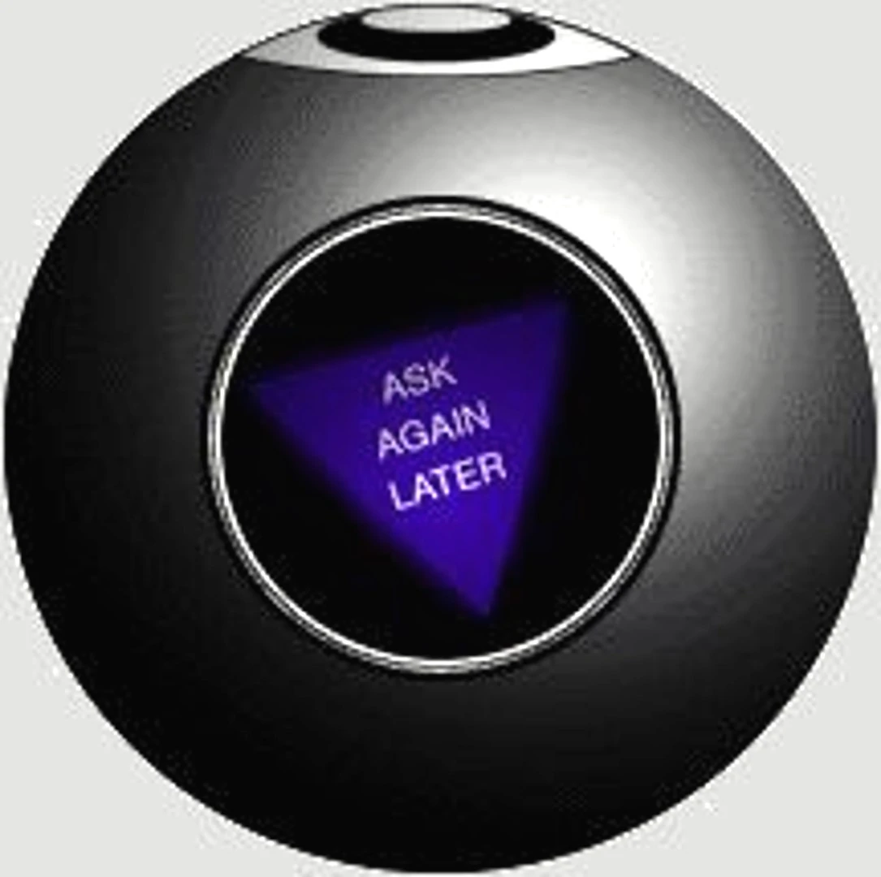
Budget
Current FY budget
Enrollment: -241 UG to 5347; Grad +108 to 980 (Net -1.5% on-campus)
  $1 million less tuition than planned = $1 million contingency gone
Next year (FY 2024)
State appropriation
  5% increase, maybe
Tuition:
  Enrollment might rise: +40% y-t-y applications but lowered yield expected
  Tuition model change to tiers, designed as net zero change
  But inflation may drive tuition increase

Slide 54
General Revenue Budget
 | FY20 | FY 21 | FY 22 | FY 23 (budgeted)
Tuition and Fees | $126,853,439 | $119,477,148 | $119,255,572 | $123,885,664
Scholarship Allowance | (37,842,663) | (36,728,607) | (38,692,747) | (41,287,426)
Discount | 30% | 31% | 32% | 33%
Net Tuition & Fees | $89,010,776 | $83,748,541 | 80,562,825 | 82,598,238
State Appropriation | 43,543,499 | 45,690,941 | 53,026,096 | 55,942,347
Gift Revenues | 385,737 | 493,109 | 441,381 | 347,500
Recovery of F & A | 6,802,499 | 6,496,349 | 7,611,796 | 7,290,000
Endowment & Investment Income | 1,992,727 | 1,891,705 | 3,399,798 | 3,391,902
Sales & Services Income | 1,177,479 | 709,380 | 1,125,303 | 999,930
Other Incomes | 2,872,553 | 2,209,518 | 2,841,403 | 2,067,024
Revenue Contingency | - |  | - | -
Total Revenues | $145,785,270 | $140,239,544 | $149,008,602 | $152,636,941
Enrollment: -241 UG, +108 grad
Blank = covers $1 MM tuition shortfall

Slide 55
General Revenue Budget: costs
Total Revenues | $145,785,270 | $140,239,544 | $149,008,602 | $152,636,941
+$3.63 million
Transfers | FY20 | FY 21 | FY 22 (actual*) | FY 23 (budgeted)
Internal | $4,442,960 | $1,988,391 | ($1,097,298) | $1,470,667
Mandatory Transfers | (3,930,896) | (3,483,219) | (3,285,882) | (3,376,171)
NonMandatory Transfers | (6,885,979) | (7,114,077) | (4,445,964) | (3,850,000)
Total Transfers | ($6,373,915) | ($8,630,105) | ($8,829,144) | ($5,755,504)
Expenditures
Salaries & Wages | $80,232,396 | $75,195,068 | $72,970,747 | $80,441,613
Benefit Expense | 25,029,887 | 24,209,899 | 23,542,539 | 27,358,459
Compensation | $105,262,283 | $99,404,966 | $96,513,286 | $107,800,0030
Other Expenses | 33,203,896 | 32,471,617 | 35,350,345 | 39,0449,616
Total Expenditures | $138,466,179 | $131,876,584 | $131,863,631 | $146,849,689
 |  |  | Increase | $14,986,058
Open:
31 Faculty
90+ Staff
Was 1.247 M increase:
Maintenance +485k
Utilities +437k
IT (from IT fee) + 26.5k
Insurance, etc. +250k
Summer session + 48k
Enroll. contingency +200k

Slide 56
Agenda
VII. New Business
A. Climate Survey Results
Dave Westenberg

Slide 57
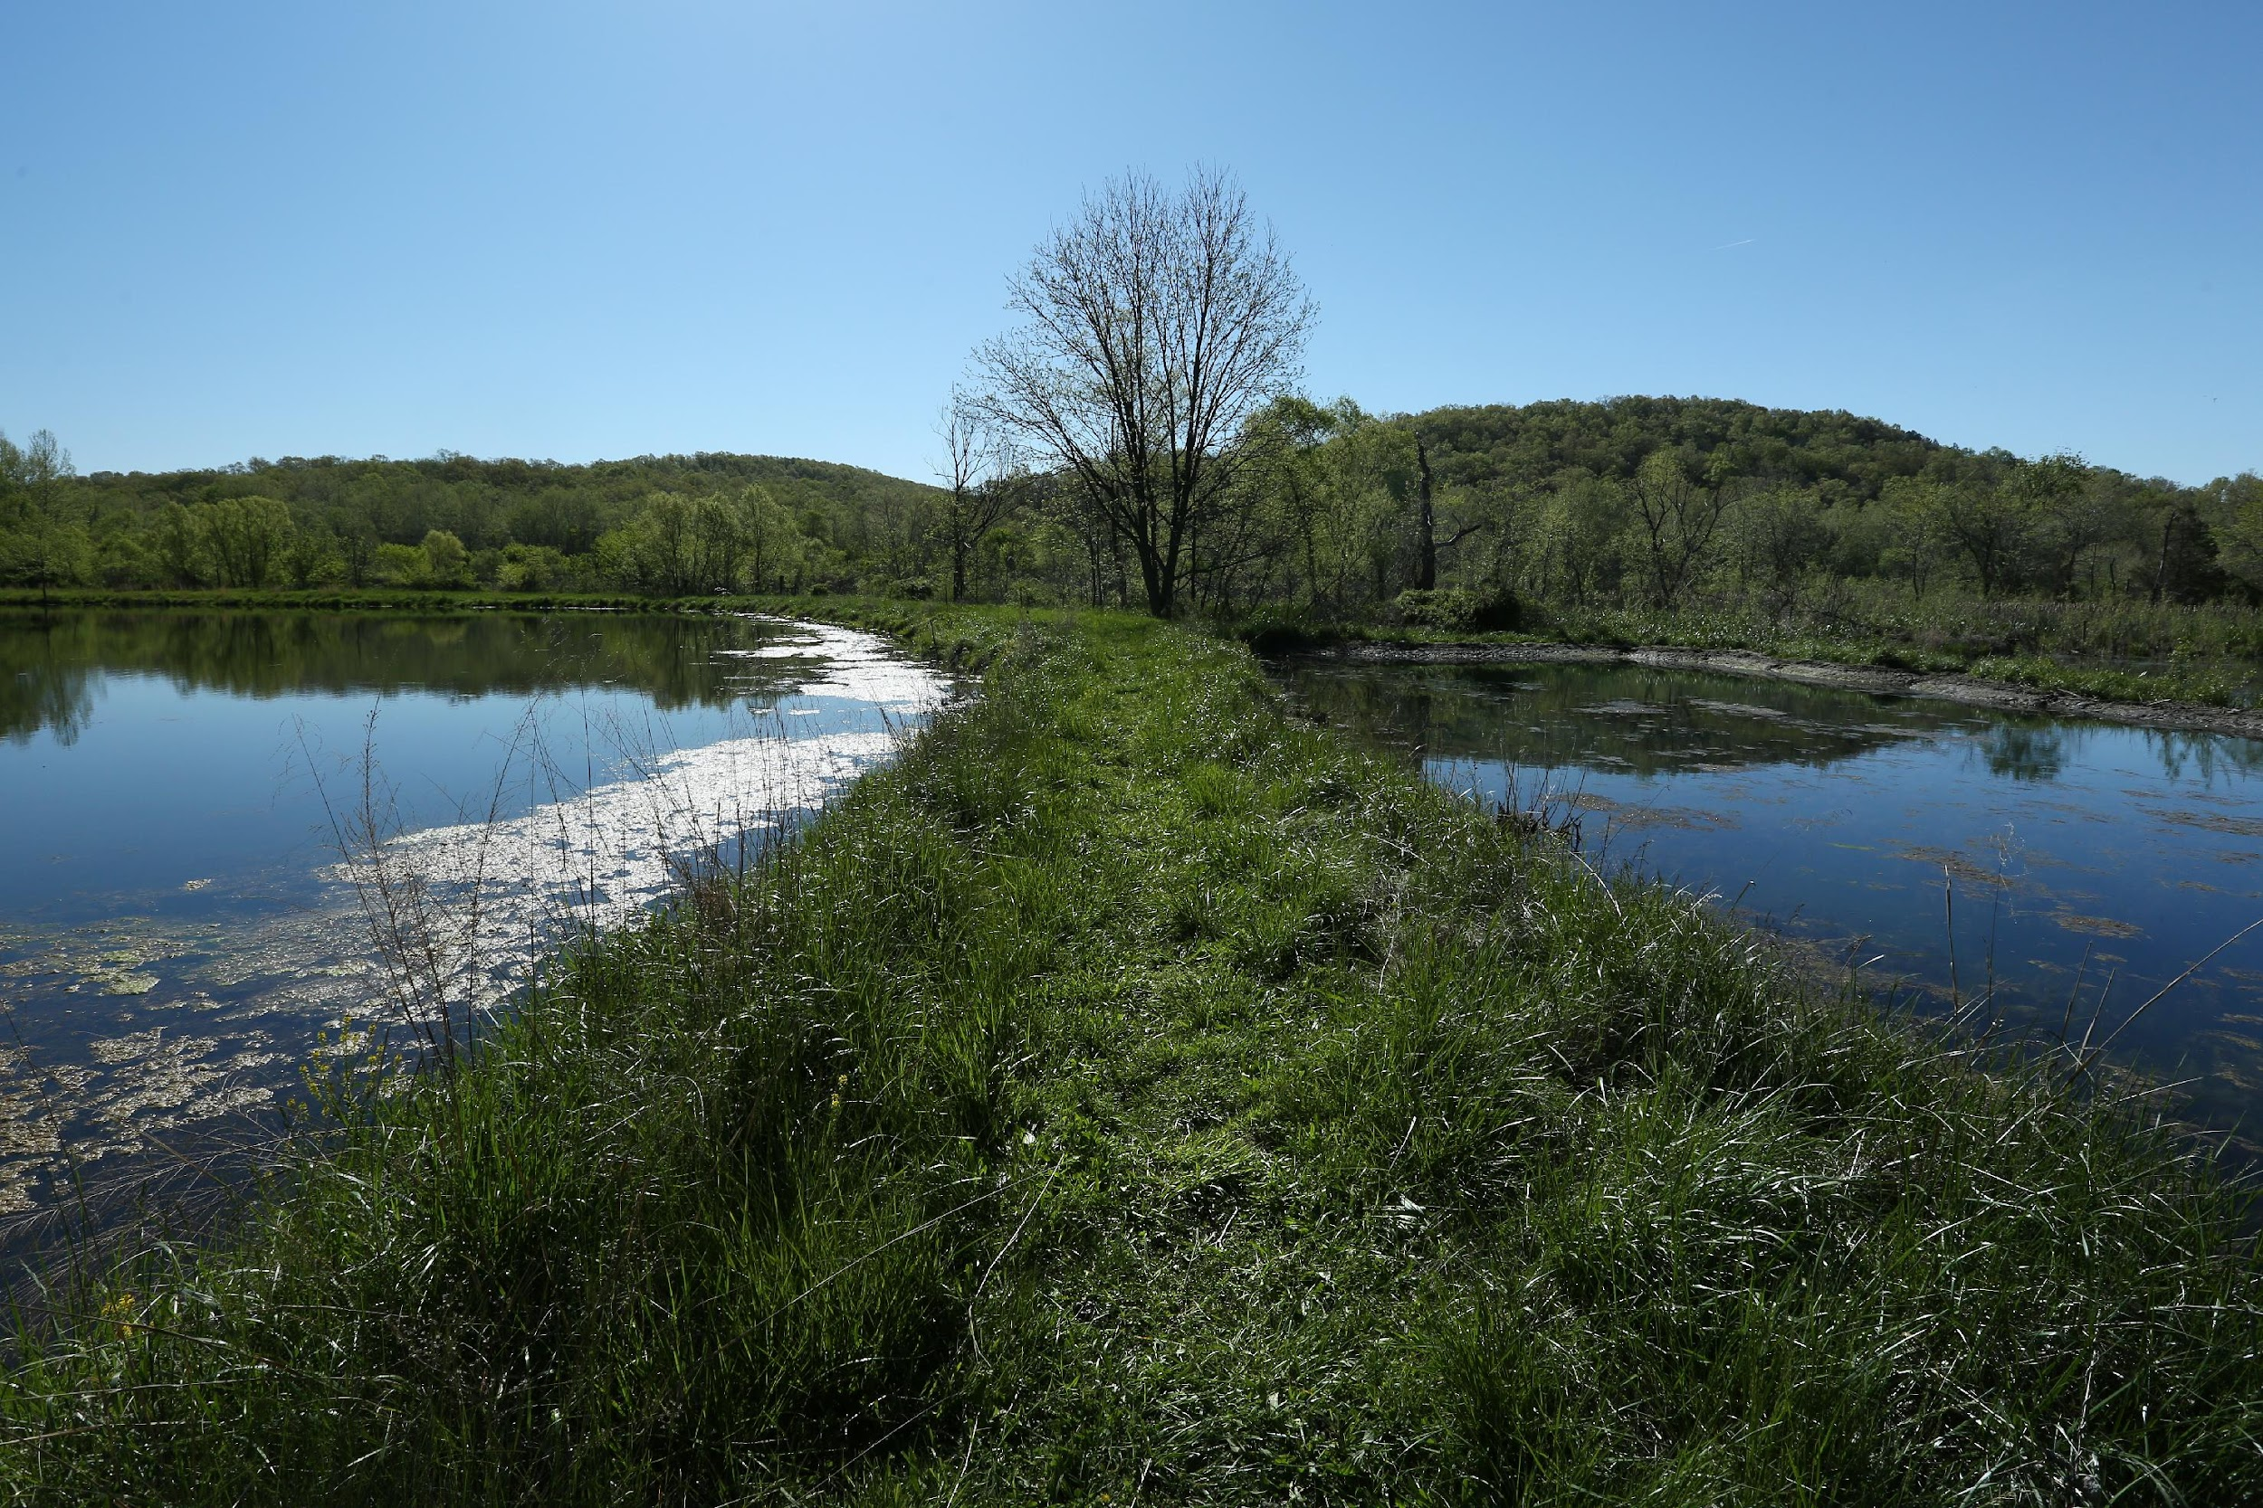
Faculty-Staff Climate Survey 2022
Updated Findings & Recommendations

Slide 58
Open-Ended Data
Support Action codes – Actions S&T has taken to support employees, their work, and/or their careers
  “List 3-5 actions Missouri S&T has taken to support you, your work, and your career.”
Action Needed codes– Actions employees wish S&T would take (or would have taken) to support them, their work, and/or their careers
  “List 3-5 actions you wish Missouri S&T would take to support you, your work, and your career.

Slide 59
Total Responses Summary
842 total support code responses, 1447 total action needed code responses
  605 more action needed code responses than support code responses
Of the 842 support code responses:
  71 were to specifically state “nothing has been done”
  Another 75 provided sarcastic or conditional (negative spin) comments along with the supportive action provided (e.g., “taken away resources”, “hasn’t fired me yet”, “10 years ago they gave me a 3% cost of living pay increase, that was my only raise in 14 years of teaching”)
  Leaving a total of 696 (82% of 842) responses indicating (pure) supportive action codes

Slide 60
S&T Support Actions

Slide 61
S&T Action Needed
Concerns w/ pay/rewards/ benefits/promotions
Concerns w/ leadership/campus direction
Concerns w/ work structures
Concerns w/ resources
Concerns w/ employee investment
  Better pay/rewards (255)
  Better pay/reward procedures (56)
  Better benefits (55)
  Promotion opportunities (30)
  Total N = 396
  Communication w/ upper leadership (83)
  Addressing negative campus climate (66)
  Improve strategy (49)
  Change/hire new leadership (41)
  Better training for leaders (19)
  Total N = 258
  Improve workload (53)
  Reduce red-tape/bureaucratic procedures (45)
  Allow more remote/flexible work (29)
  Role clarity (22)
  Total N = 181
  Hire more staff (67)
  Better equipment/technology (28)
  Better physical space (22)
  Better resources (21)
  Budget transparency (20)
  Student support (18)
  Hire more faculty (12)
  Total N = 188
  Better recognition (82)
  Better research/career investment (61)
  Improve equity (61)
  Training & development (51)
  Trust frontline (43)
  More support (41)
  Improve respect for staff (37)
  Care for employee well-being/mental health (25)
  Improve collaboration (17)
  Total N = 399
*25 responses did not clearly align with any category or concept

Slide 62
S&T Action Needed

Slide 63
Evidence-Based Recommendations

Slide 64
Potential Short-Term “Wins”
Initial action taken
  Summer 2022 staff market raises
  Summer 2022 staff & faculty merit raises
  Leadership training courses
Other opportunities
  Communication w/ upper leadership
  Reducing red-tape/bureaucratic procedures
  Continued development opportunities
  Increasing recognition & improve respect for staff

Slide 65
Other Opportunities
Communication with Upper Leadership
Getting to know employees directly
  Also addresses: Improving respect for staff, trusting the frontline
Incorporate greater employee voice into decision-making
  Also addresses trusting the frontline
Transparency
Professional communication (e.g., listening/acknowledging & following-up on concerns)
  Also addresses negative campus climate concerns
Can help improve interpersonal and informational justice

Slide 66
Other Opportunities
Reducing Red-tape/Bureaucratic Procedures
Example: Graduate Education revamping graduate forms processes
#1 identified challenge: HR/hiring processes
  Action Steps: Task force to work with Cindi Nelson on feasible new processes
  Pilot-test approach (if possible)
Also considering better pay/reward procedures
  #1 issue according to quantitative data

Slide 67
Other Opportunities
Continued Development Opportunities
Identified as the #1 support action
  Emphasized training opportunities/programs
  Followed by growth/responsibility/leadership opportunities
Possible Examples
  Directive about allowing specific hourly time for training
  Formal mentoring program (staff in particular)

Slide 68
Other Opportunities
Increased Recognition & Improve Respect for Staff
Bring back Years of Service recognition (and monetary support)
  Consider other staff awards (e.g., exceptional contributions to university)
Spend more physical time with departments (administrative & academic) to understand what they do and how they contribute to the university
  Also addresses trusting the frontline, communication w/ upper leadership
Can help improve perceived organizational support

Slide 69
Long Term Strategy
Benefits considerations
  #2 most cited support action (particularly among staff), recently suffered a set-back
  Threatens already existing challenges in justice perceptions
What are 2-3 strategic areas that leadership could build scaffolded steps towards improvement?
  What milestones can be set along the way?
  Short-term wins into long-term strategy

Slide 70
Faculty and Staff Climate Survey
Actions and Next Steps
Colin Potts, Provost

Slide 71
Faculty Survey Summary Categories
Pay, rewards, benefits and promotions
Work structures
Resources
Employee investment
Leadership and campus direction

Slide 72
Pay, rewards, benefits and promotions
Actions taken
  Review of salaries and wages for staff positions
  Invested $1.6M toward making staff pay more competitive
    Raised minimum hourly pay from $11.35 to $14.50/hour
    Increased minimum starting pay in grades 4-12 by 10%
  Provided 3.5% merit-based salary and wage pool for staff, 4.0% for faculty
  Initiated leadership, management and professional development program
  Hired Staff Success Center Manager (Nov 1 start)
Next steps
Continuous review of salaries and wages with a focus on high turnover and difficult to fill job families
Promote leadership, management and professional development training opportunities for staff
Fully launch Staff Success Center

Slide 73
Work structures
Actions taken
  Empower deans, chairs, unit directors, etc., to manage workload (academic and non-academic)
  Empower departmental and unit-level leaders and supervisors to determine remote/flexible work where applicable (not all duties can be carried out remotely)
Next steps
  Continue to review workload policies
  Provide greater training opportunities for new supervisors
  Determine opportunities to remove “red tape”

Slide 74
Resources
Actions taken
  Improved processes for recruitment and onboarding of faculty and staff
  Currently recruiting benefit-eligible positions
    85 staff positions
    31 faculty positions
    17 post doc positions
  Major construction activities to position S&T for growth
  VC for Finance and Ops kicking off information series in November
    S&T Budget 101, FY24 Financial Outlook, Tuition Structure changes, Campus Construction update, Kummer Investments, HR Goals and Metrics, Status of Physical Plant, etc.
Next steps
  Continue to improve recruitment and onboarding processes for faculty and staff
  Continuous improvement of physical space
  Continue sharing financial and other information with campus stakeholders

Slide 75
Employee investment
Actions taken
  Invested $5.4M in employee compensation this year
    $1.9M toward making staff pay more competitive
    $3.5M in merit-based salary and wage increases for staff and faculty
  Initiated leadership, management and professional development program
  Additional recognition through Staff Excellence Awards
    Value of award increased to $1,000 from $400
  Hired Staff Success Center Manager (Nov 1 start)
Next steps
  Continuous review of salaries and wages with a focus on high turnover and difficult to fill job families
  Promote leadership, management and professional development training opportunities for staff
  Continue to work with Staff Council for recognition and training opportunities for staff
  Fully launch Staff Success Center

Slide 76
Leadership and campus direction
Actions taken
  Chancellor and Provost meetings with colleges, academic and non-academic departments
  Initiated leadership, management and professional development program
  Initiated Vision, Strategy and Execution Priorities (VSE) planning for S&T and aligned with North Star goals (recruitment, retention, research, reputation)
Next steps
  Continue and expand regular meetings with departments, individual faculty and staff
  Promote leadership, management and professional development training opportunities for staff
  Shared governance working groups on urgent and important issues
  - e.g. Library 2050 planning

Slide 77
Thank you. Questions?

Slide 78
Agenda
VIII. Adjourn
78

